Slide 1
Data Mining:
Concepts and Techniques
— Chapter 6 —
Jiawei Han and Micheline Kamber
Department of Computer Science
University of Illinois at Urbana-Champaign
www.cs.uiuc.edu/~hanj
©2006 Jiawei Han and Micheline Kamber. All rights reserved.

Slide 2
Chapter 6. Classification and Prediction
What is classification? What is prediction?
Issues regarding classification and prediction
Classification by decision tree induction
Bayesian classification
Rule-based classification
Classification by back propagation
Support Vector Machines (SVM)
Associative classification
Lazy learners (or learning from your neighbors)
Other classification methods
Prediction
Accuracy and error measures
Ensemble methods
Model selection
Summary

Slide 3
Classification vs. Prediction
Classification
  predicts categorical class labels (discrete or nominal)
  classifies data (constructs a model) based on the training set and the values (class labels) in a classifying attribute and uses it in classifying new data
Prediction
  models continuous-valued functions, i.e., predicts unknown or missing values
Typical applications
  Credit approval
  Target marketing
  Medical diagnosis
  Fraud detection

Slide 4
Classification—A Two-Step Process
Model construction: describing a set of predetermined classes
  Each tuple/sample is assumed to belong to a predefined class, as determined by the class label attribute
  The set of tuples used for model construction is training set
  The model is represented as classification rules, decision trees, or mathematical formulae
Model usage: for classifying future or unknown objects
  Estimate accuracy of the model
    The known label of test sample is compared with the classified result from the model
    Accuracy rate is the percentage of test set samples that are correctly classified by the model
    Test set is independent of training set, otherwise over-fitting will occur
  If the accuracy is acceptable, use the model to classify data tuples whose class labels are not known

Slide 5



Process (1): Model Construction
Classification
Algorithms
Training
Data
Classifier
(Model)
IF rank = ‘professor’
OR years > 6
THEN tenured = ‘yes’

Slide 6




Process (2): Using the Model in Prediction
Classifier
Testing
Data
Unseen Data
(Jeff, Professor, 4)
Tenured?

Slide 7
Supervised vs. Unsupervised Learning
Supervised learning (classification)
  Supervision: The training data (observations, measurements, etc.) are accompanied by labels indicating the class of the observations
  New data is classified based on the training set
Unsupervised learning (clustering)
  The class labels of training data is unknown
  Given a set of measurements, observations, etc. with the aim of establishing the existence of classes or clusters in the data

Slide 8
Chapter 6. Classification and Prediction
What is classification? What is prediction?
Issues regarding classification and prediction
Classification by decision tree induction
Bayesian classification
Rule-based classification
Classification by back propagation
Support Vector Machines (SVM)
Associative classification
Lazy learners (or learning from your neighbors)
Other classification methods
Prediction
Accuracy and error measures
Ensemble methods
Model selection
Summary

Slide 9
Issues: Data Preparation
Data cleaning
  Preprocess data in order to reduce noise and handle missing values
Relevance analysis (feature selection)
  Remove the irrelevant or redundant attributes
Data transformation
  Generalize and/or normalize data

Slide 10
Issues: Evaluating Classification Methods
Accuracy
  classifier accuracy: predicting class label
  predictor accuracy: guessing value of predicted attributes
Speed
  time to construct the model (training time)
  time to use the model (classification/prediction time)
Robustness: handling noise and missing values
Scalability: efficiency in disk-resident databases
Interpretability
  understanding and insight provided by the model
Other measures, e.g., goodness of rules, such as decision tree size or compactness of classification rules

Slide 11
Chapter 6. Classification and Prediction
What is classification? What is prediction?
Issues regarding classification and prediction
Classification by decision tree induction
Bayesian classification
Rule-based classification
Classification by back propagation
Support Vector Machines (SVM)
Associative classification
Lazy learners (or learning from your neighbors)
Other classification methods
Prediction
Accuracy and error measures
Ensemble methods
Model selection
Summary

Slide 12

Example of a Decision Tree
Splitting Attributes
Refund
Yes
No
NO
MarSt
Single, Divorced
Married
TaxInc
NO
< 80K
> 80K
NO
YES
Model: Decision Tree
Training Data

Slide 13
Another Example
MarSt
Single, Divorced
Married
NO
Refund
Yes
No
NO
TaxInc
< 80K
> 80K
NO
YES
There could be more than one tree that fits the same data!

Slide 14

Decision Tree Classification
Decision Tree

Slide 15

Apply Model to Test Data
Test Data
Start from the root of tree.
Refund
Yes
No
NO
MarSt
Single, Divorced
Married
TaxInc
NO
< 80K
> 80K
NO
YES

Slide 16
Apply Model to Test Data
Test Data
Refund
Yes
No
NO
MarSt
Single, Divorced
Married
TaxInc
NO
< 80K
> 80K
NO
YES

Slide 17

Apply Model to Test Data
Test Data
Refund
Yes
No
NO
MarSt
Single, Divorced
Married
TaxInc
NO
< 80K
> 80K
NO
YES

Slide 18
Apply Model to Test Data
Test Data
Refund
Yes
No
NO
MarSt
Single, Divorced
Married
TaxInc
NO
< 80K
> 80K
NO
YES

Slide 19

Apply Model to Test Data
Test Data
Refund
Yes
No
NO
MarSt
Single, Divorced
Married
TaxInc
NO
< 80K
> 80K
NO
YES

Slide 20
Apply Model to Test Data
Test Data
Refund
Yes
No
NO
MarSt
Single, Divorced
Married
Assign Cheat to “No”
TaxInc
NO
< 80K
> 80K
NO
YES

Slide 21

Decision Tree Classification
Decision Tree

Slide 22
Decision Tree Induction
Many Algorithms:
  Hunt’s Algorithm (one of the earliest)
  CART
  ID3, C4.5
  SLIQ, SPRINT

Slide 23
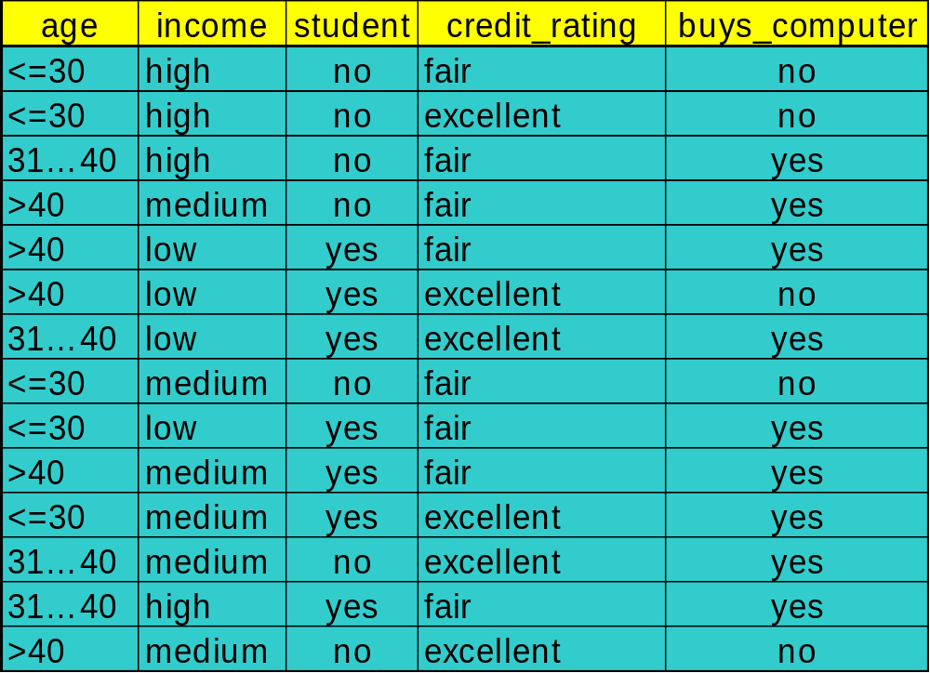
Decision Tree Induction: Training Dataset
This follows an example of Quinlan’s ID3 (Playing Tennis)

Slide 24
Output: A Decision Tree for “buys_computer”
age?
<=30
overcast
>40
31..40
student?
yes
credit rating?
no
yes
excellent
fair
no
yes
no
yes

Slide 25
Algorithm for Decision Tree Induction
Basic algorithm (a greedy algorithm)
  Tree is constructed in a top-down recursive divide-and-conquer manner
  At start, all the training examples are at the root
  Attributes are categorical (if continuous-valued, they are discretized in advance)
  Examples are partitioned recursively based on selected attributes
  Test attributes are selected on the basis of a heuristic or statistical measure (e.g., information gain)
Conditions for stopping partitioning
  All samples for a given node belong to the same class
  There are no remaining attributes for further partitioning – majority voting is employed for classifying the leaf
  There are no samples left

Slide 26

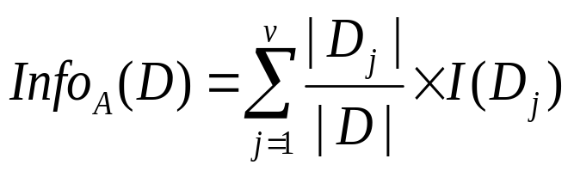

Attribute Selection Measure: Information Gain (ID3/C4.5)
Select the attribute with the highest information gain
Let p_{i} be the probability that an arbitrary tuple in D belongs to class C_{i}, estimated by |C_{i, D}|/|D|
Expected information (entropy) needed to classify a tuple in D:
Information needed (after using A to split D into v partitions) to classify D:
Information gained by branching on attribute A
Notes:
I : the expected information needed to classify a given sample
E (entropy) : expected information based on the partitioning into subsets by A

Slide 27





Attribute Selection: Information Gain
Class P: buys_computer = “yes”
Class N: buys_computer = “no”
means “age <=30” has 5 out of 14 samples, with 2 yes’es and 3 no’s. Hence
Similarly,

Slide 28
Computing Information-Gain for Continuous-Value Attributes
Let attribute A be a continuous-valued attribute
Must determine the best split point for A
  Sort the value A in increasing order
  Typically, the midpoint between each pair of adjacent values is considered as a possible split point
    (a_{i}+a_{i+1})/2 is the midpoint between the values of a_{i} and a_{i+1}
  The point with the minimum expected information requirement for A is selected as the split-point for A
Split:
  D1 is the set of tuples in D satisfying A ≤ split-point, and D2 is the set of tuples in D satisfying A > split-point

Slide 29

Gain Ratio for Attribute Selection (C4.5)
Information gain measure is biased towards attributes with a large number of values
C4.5 (a successor of ID3) uses gain ratio to overcome the problem (normalization to information gain)
  GainRatio(A) = Gain(A)/SplitInfo(A)
Ex.
  gain_ratio(income) = 0.029/0.926 = 0.031
The attribute with the maximum gain ratio is selected as the splitting attribute

Slide 30



Gini index (CART, IBM IntelligentMiner)
If a data set D contains examples from n classes, gini index, gini(D) is defined as
where p_{j} is the relative frequency of class j in D
If a data set D is split on A into two subsets D₁ and D₂, the gini index gini(D) is defined as
Reduction in Impurity:
The attribute provides the smallest gini_{split}(D) (or the largest reduction in impurity) is chosen to split the node (need to enumerate all the possible splitting points for each attribute)

Slide 31


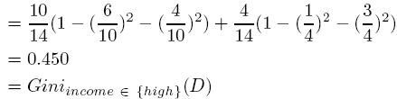
Gini index (CART, IBM IntelligentMiner)
Ex. D has 9 tuples in buys_computer = “yes” and 5 in “no”
Suppose the attribute income partitions D into 10 in D₁: {low, medium} and 4 in D₂
  but gini_{{medium,high}} is 0.30 and thus the best since it is the lowest
All attributes are assumed continuous-valued
May need other tools, e.g., clustering, to get the possible split values
Can be modified for categorical attributes

Slide 32




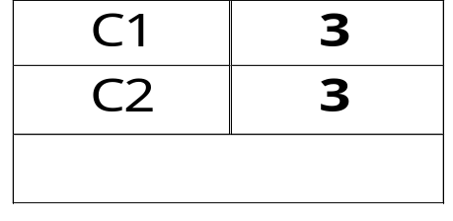
Examples for computing GINI
P(C1) = 0/6 = 0 P(C2) = 6/6 = 1
Gini = 1 – P(C1)² – P(C2)² = 1 – 0 – 1 = 0
P(C1) = 1/6 P(C2) = 5/6
Gini = 1 – (1/6)² – (5/6)² = 0.278
P(C1) = 2/6 P(C2) = 4/6
Gini = 1 – (2/6)² – (4/6)² = 0.444
P(C1) = 3/6 P(C2) = 3/6
Gini = 1 – (3/6)² – (3/6)² = 0.5

Slide 33

Splitting Based on GINI
When a node p is split into k partitions (children), the quality of split is computed as,
where, n_{i} = number of records at child i,
n = number of records at node p

Slide 34

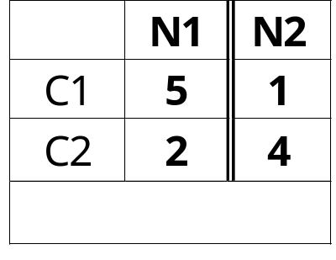
Binary Attributes: Computing GINI Index
Splits into two partitions
Effect of Weighing partitions:
  Larger and purer partitions are sought for
B?
Yes
No
Node N1
Node N2
Gini(N1)
= 1 – (5/7)² – (2/7)²
= 0.408
Gini(N2)
= 1 – (1/5)² – (4/5)²
= 0.32
Gini(Children)
= 7/12 * 0.408 +
5/12 * 0.32
= 0.371

Slide 35



Categorical Attributes: Computing Gini Index
For each distinct value, gather counts for each class in the dataset
Use the count matrix to make decisions
Multi-way split
Two-way split
(find best partition of values)

Slide 36

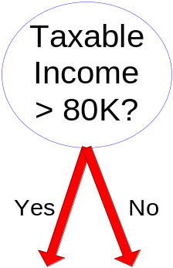
Continuous Attributes: Computing Gini Index
Use Binary Decisions based on one value
Several Choices for the splitting value
  Number of possible splitting values
  = Number of distinct values
Each splitting value has a count matrix associated with it
  Class counts in each of the partitions, A < v and A ≥ v

Slide 37
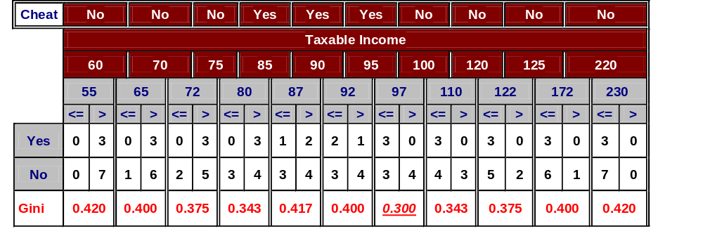
Continuous Attributes: Computing Gini Index...
For each continuous attribute,
  Sort the attribute on values
  Choose a split position midway between any two values
  Linearly scan these values, each time updating the count matrix and computing gini index
  Choose the split position that has the least gini index
Sorted Values
Split Positions

Slide 38
Comparing Attribute Selection Measures
The three measures, in general, return good results but
  Information gain:
    biased towards multivalued attributes
  Gain ratio:
    tends to prefer unbalanced splits in which one partition is much smaller than the others
  Gini index:
    biased to multivalued attributes
    has difficulty when # of classes is large
    tends to favor tests that result in equal-sized partitions and purity in both partitions

Slide 39
Other Attribute Selection Measures
CHAID: a popular decision tree algorithm, measure based on χ² test for independence
C-SEP: performs better than info. gain and gini index in certain cases
G-statistics: has a close approximation to χ² distribution
MDL (Minimal Description Length) principle (i.e., the simplest solution is preferred):
  The best tree as the one that requires the fewest # of bits to both (1) encode the tree, and (2) encode the exceptions to the tree
Multivariate splits (partition based on multiple variable combinations)
  CART: finds multivariate splits based on a linear comb. of attrs.
Which attribute selection measure is the best?
  Most give good results, none is significantly superior than others

Slide 40
Overfitting and Tree Pruning
Overfitting: An induced tree may overfit the training data
  Too many branches, some may reflect anomalies due to noise or outliers
  Poor accuracy for unseen samples
Two approaches to avoid overfitting
  Prepruning: Halt tree construction early—do not split a node if this would result in the goodness measure falling below a threshold
    Difficult to choose an appropriate threshold
  Postpruning: Remove branches from a “fully grown” tree—get a sequence of progressively pruned trees
    Use a set of data different from the training data to decide which is the “best pruned tree”

Slide 41
Enhancements to Basic Decision Tree Induction
Allow for continuous-valued attributes
  Dynamically define new discrete-valued attributes that partition the continuous attribute value into a discrete set of intervals
Handle missing attribute values
  Assign the most common value of the attribute
  Assign probability to each of the possible values
Attribute construction
  Create new attributes based on existing ones that are sparsely represented
  This reduces fragmentation, repetition, and replication

Slide 42
Classification in Large Databases
Classification—a classical problem extensively studied by statisticians and machine learning researchers
Scalability: Classifying data sets with millions of examples and hundreds of attributes with reasonable speed
Why decision tree induction in data mining?
  relatively faster learning speed (than other classification methods)
  convertible to simple and easy to understand classification rules
  can use SQL queries for accessing databases
  comparable classification accuracy with other methods

Slide 43
Scalable Decision Tree Induction Methods
SLIQ (EDBT’96 — Mehta et al.)
  Builds an index for each attribute and only class list and the current attribute list reside in memory
SPRINT (VLDB’96 — J. Shafer et al.)
  Constructs an attribute list data structure
PUBLIC (VLDB’98 — Rastogi & Shim)
  Integrates tree splitting and tree pruning: stop growing the tree earlier
RainForest (VLDB’98 — Gehrke, Ramakrishnan & Ganti)
  Builds an AVC-list (attribute, value, class label)
BOAT (PODS’99 — Gehrke, Ganti, Ramakrishnan & Loh)
  Uses bootstrapping to create several small samples

Slide 44
Chapter 6. Classification and Prediction
What is classification? What is prediction?
Issues regarding classification and prediction
Classification by decision tree induction
Bayesian classification
Rule-based classification
Classification by back propagation
Support Vector Machines (SVM)
Associative classification
Lazy learners (or learning from your neighbors)
Other classification methods
Prediction
Accuracy and error measures
Ensemble methods
Model selection
Summary

Slide 45
Using IF-THEN Rules for Classification
Represent the knowledge in the form of IF-THEN rules
  R: IF age = youth AND student = yes THEN buys_computer = yes
  Rule antecedent/precondition vs. rule consequent
Assessment of a rule: coverage and accuracy
  n_{covers} = # of tuples covered by R
  n_{correct} = # of tuples correctly classified by R
  coverage(R) = n_{covers} /|D| /* D: training data set */
  accuracy(R) = n_{correct} / n_{covers}
If more than one rule are triggered, need conflict resolution
  Size ordering: assign the highest priority to the triggering rules that has the “toughest” requirement (i.e., with the most attribute test)
  Class-based ordering: decreasing order of prevalence or misclassification cost per class
  Rule-based ordering (decision list): rules are organized into one long priority list, according to some measure of rule quality or by experts

Slide 46
Rule Extraction from a Decision Tree
age?
<=30
31..40
>40
Rules are easier to understand than large trees
One rule is created for each path from the root to a leaf
Each attribute-value pair along a path forms a conjunction: the leaf holds the class prediction
Rules are mutually exclusive and exhaustive
student?
yes
credit rating?
no
yes
excellent
fair
no
yes
no
yes
Example: Rule extraction from our buys_computer decision-tree
  IF age = young AND student = no THEN buys_computer = no
  IF age = young AND student = yes THEN buys_computer = yes
  IF age = mid-age THEN buys_computer = yes
  IF age = old AND credit_rating = excellent THEN buys_computer = yes
  IF age = young AND credit_rating = fair THEN buys_computer = no

Slide 47
Rule Extraction from the Training Data
Sequential covering algorithm: Extracts rules directly from training data
Typical sequential covering algorithms: FOIL, AQ, CN2, RIPPER
Rules are learned sequentially, each for a given class C_{i} will cover many tuples of C_{i} but none (or few) of the tuples of other classes
Steps:
  Rules are learned one at a time
  Each time a rule is learned, the tuples covered by the rules are removed
  The process repeats on the remaining tuples unless termination condition, e.g., when no more training examples or when the quality of a rule returned is below a user-specified threshold
Comp. w. decision-tree induction: learning a set of rules simultaneously

Slide 48
Sequential Covering Algorithm
while (enough target tuples left)
  generate a rule
  remove positive target tuples satisfying this rule
Examples covered
by Rule 2
Examples covered
by Rule 1
Examples covered
by Rule 3
Positive examples

Slide 49


How to Learn-One-Rule?
Star with the most general rule possible: condition = empty
Adding new attributes by adopting a greedy depth-first strategy
  Picks the one that most improves the rule quality
Rule-Quality measures: consider both coverage and accuracy
  Foil-gain (in FOIL & RIPPER): assesses info_gain by extending condition
    It favors rules that have high accuracy and cover many positive tuples
Rule pruning based on an independent set of test tuples
    Pos/neg are # of positive/negative tuples covered by R.
    If FOIL_Prune is higher for the pruned version of R, prune R

Slide 50
Rule Generation
To generate a rule
  while(true)
  find the best predicate p
  if foil-gain(p) > threshold then add p to current rule
  else break
A3=1
A3=1&&A1=2
A3=1&&A1=2
&&A8=5
Positive examples
Negative examples

Slide 51
Chapter 6. Classification and Prediction
What is classification? What is prediction?
Issues regarding classification and prediction
Classification by decision tree induction
Bayesian classification
Rule-based classification
Classification by back propagation
Support Vector Machines (SVM)
Associative classification
Lazy learners (or learning from your neighbors)
Other classification methods
Prediction
Accuracy and error measures
Ensemble methods
Model selection
Summary

Slide 52
Lazy vs. Eager Learning
Lazy vs. eager learning
  Lazy learning (e.g., instance-based learning): Simply stores training data (or only minor processing) and waits until it is given a test tuple
  Eager learning (the above discussed methods): Given a set of training set, constructs a classification model before receiving new (e.g., test) data to classify
Lazy: less time in training but more time in predicting
Accuracy
  Lazy method effectively uses a richer hypothesis space since it uses many local linear functions to form its implicit global approximation to the target function
  Eager: must commit to a single hypothesis that covers the entire instance space

Slide 53
Lazy Learner: Instance-Based Methods
Instance-based learning:
  Store training examples and delay the processing (“lazy evaluation”) until a new instance must be classified
Typical approaches
  k-nearest neighbor approach
    Instances represented as points in a Euclidean space.
  Locally weighted regression
    Constructs local approximation
  Case-based reasoning
    Uses symbolic representations and knowledge-based inference

Slide 54
The k-Nearest Neighbor Algorithm
All instances correspond to points in the n-D space
The nearest neighbor are defined in terms of Euclidean distance, dist(X₁, X₂)
Target function could be discrete- or real- valued
For discrete-valued, k-NN returns the most common value among the k training examples nearest to x_{q}
Vonoroi diagram: the decision surface induced by 1-NN for a typical set of training examples
_
.
_
_
.
+
_
.
+
.
.
_
x_{q}
+
_
.
+

Slide 55
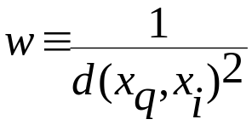
Discussion on the k-NN Algorithm
k-NN for real-valued prediction for a given unknown tuple
  Returns the mean values of the k nearest neighbors
Distance-weighted nearest neighbor algorithm
  Weight the contribution of each of the k neighbors according to their distance to the query x_{q}
    Give greater weight to closer neighbors
Robust to noisy data by averaging k-nearest neighbors
Curse of dimensionality: distance between neighbors could be dominated by irrelevant attributes
  To overcome it, axes stretch or elimination of the least relevant attributes

Slide 56
Case-Based Reasoning (CBR)
CBR: Uses a database of problem solutions to solve new problems
Store symbolic description (tuples or cases)—not points in a Euclidean space
Applications: Customer-service (product-related diagnosis), legal ruling
Methodology
  Instances represented by rich symbolic descriptions (e.g., function graphs)
  Search for similar cases, multiple retrieved cases may be combined
  Tight coupling between case retrieval, knowledge-based reasoning, and problem solving
Challenges
  Find a good similarity metric
  Indexing based on syntactic similarity measure, and when failure, backtracking, and adapting to additional cases

